Slide 1

Game Zone Management System
Transforming Game Center Operations through Advanced Database Solutions. This comprehensive project provides a centralized management system for tracking game inventory, customer interactions, and financial data, designed to streamline operations for gaming businesses of all sizes.
VASU AGRAWAL N201
DEV SHAH N213
PRAKHAR JAIN N225

Slide 2

Project Overview
Centralized Management
Comprehensive Tracking
Scalable Solution
A unified system designed for efficient game center operations.
Monitors game inventory, customer data, and financial metrics.
Suited for both small and large gaming businesses.
The project tackles manual management challenges, providing a scalable solution for small to large gaming businesses, enhancing overall efficiency and data accuracy.

Slide 3

Project Objectives
Streamline Inventory
Improve Membership Management
Efficiently track game inventory to optimize resource allocation.
Enhance customer engagement through effective membership tracking.
Enhance Revenue Reporting
Improve financial oversight with detailed reports.
The primary objectives include streamlining game inventory tracking, improving customer membership management, and enhancing revenue monitoring and reporting to facilitate informed business decisions.

Slide 4




Business Problems Addressed
Inefficient Record-Keeping
Limited Customer Tracking
Lack of Usage Insights
This initiative directly tackles inefficient manual processes and limited insights. Complex billing and poor inventory control are addressed. It offers comprehensive customer tracking and game usage analytics.

Slide 5
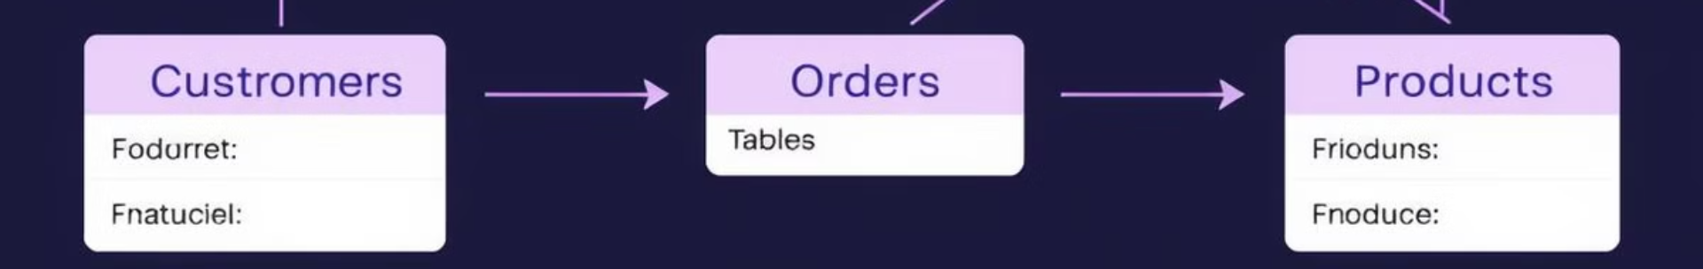



Database Architecture
RDBMS
Relational Database Management System for structured data storage.
Normalized Design
Ensures data integrity and reduces redundancy.
Key Entities
Customers, Games, Memberships, Rentals, and Inventory are managed.
Built on an RDBMS, the normalized database design includes key entities such as Customers, Games, Memberships, and Rentals, ensuring data integrity and security.

Slide 6
Entity-Relationship Diagram
Detailed Mapping
Normalized Tables
Optimized Structure
Visual representation of database relationships.
Ensures efficient data management.
Designed for performance and scalability.
The ER diagram provides a detailed mapping of database relationships, showcasing primary and foreign key connections and normalized table structures optimized for scalability.

Slide 7
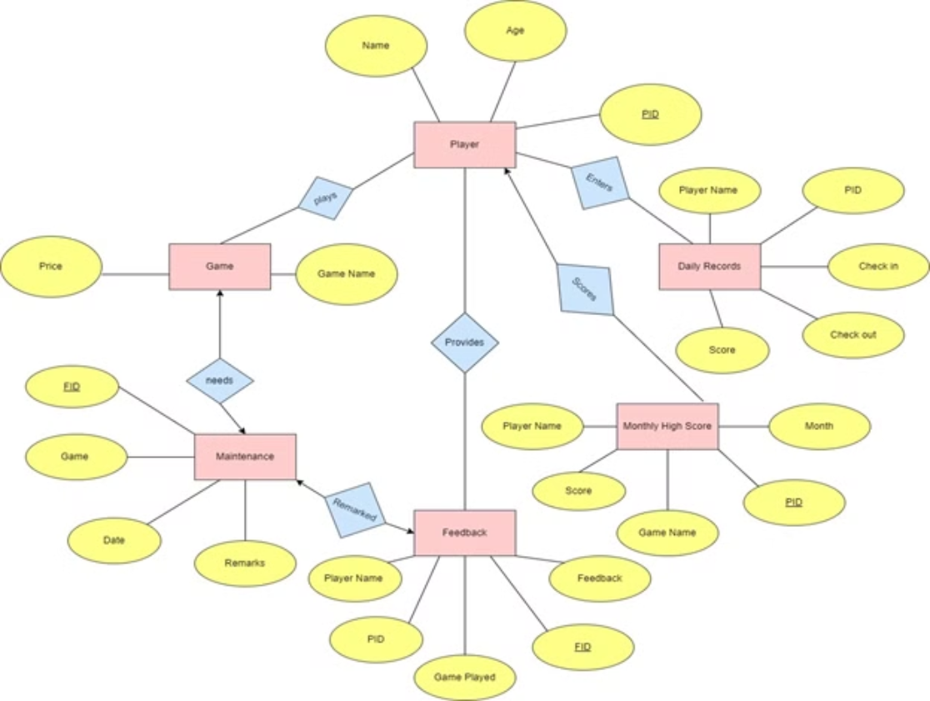
ER Diagram

Slide 8
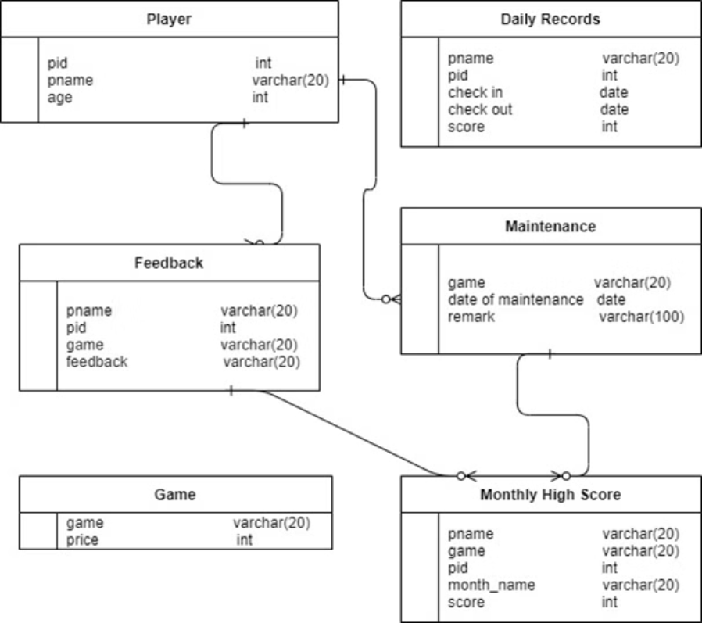
Relational Schema

Slide 9
Creating Tables
CREATE TABLE player ( pid INT PRIMARY KEY, pname VARCHAR(20) NOT NULL, age INT );
CREATE TABLE daily_records ( pid INT, pname VARCHAR(20) NOT NULL, check_in DATE, check_out DATE, score INT, FOREIGN KEY (pid) REFERENCES player(pid) ON DELETE CASCADE );
CREATE TABLE monthly_high_score ( pid INT, pname VARCHAR(20) NOT NULL, score INT, game VARCHAR(20), month_name VARCHAR(20), FOREIGN KEY (pid) REFERENCES player(pid) ON DELETE CASCADE );
CREATE TABLE feedback ( pid INT, pname VARCHAR(20) NOT NULL, game VARCHAR(20), feedback VARCHAR(100), FOREIGN KEY (pid) REFERENCES player(pid) ON DELETE CASCADE );
CREATE TABLE maintenance ( game VARCHAR(20) PRIMARY KEY, date_of_maintenance DATE, remarks VARCHAR(100) );
CREATE TABLE game ( game VARCHAR(20) PRIMARY KEY, price INT );

Slide 10
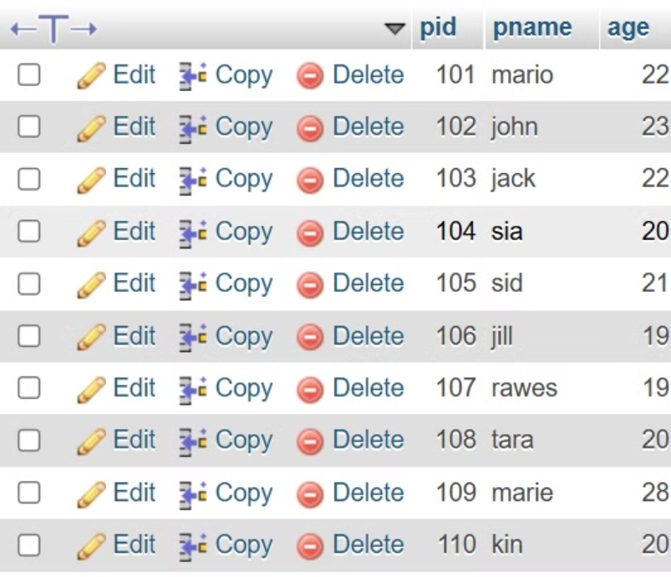
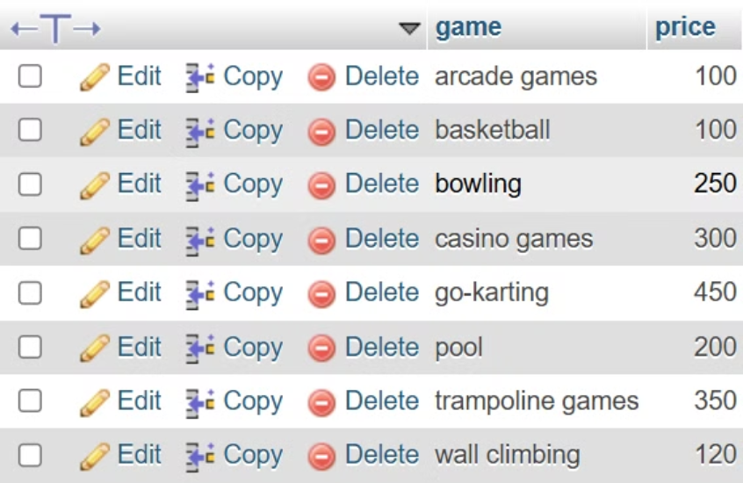
Inserting Values
INSER INTO tablename(<COLUMN NAMES>) VALUES

Slide 11
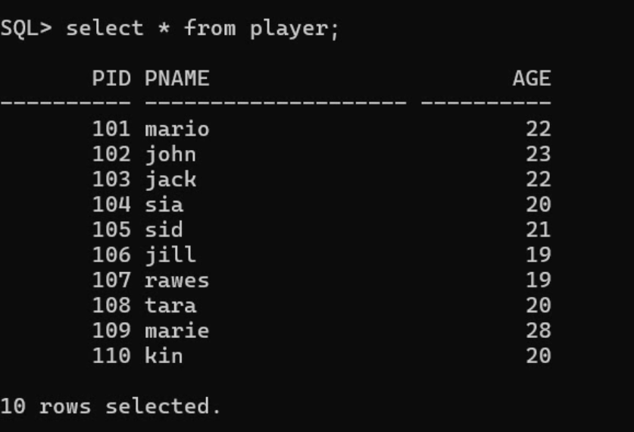
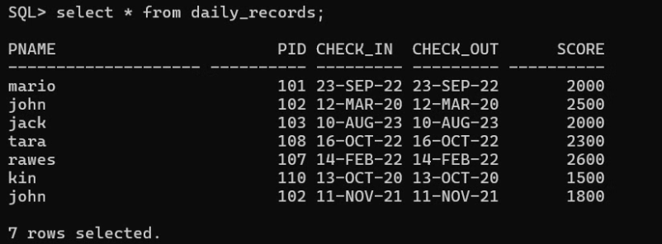
Running Queries

Slide 12
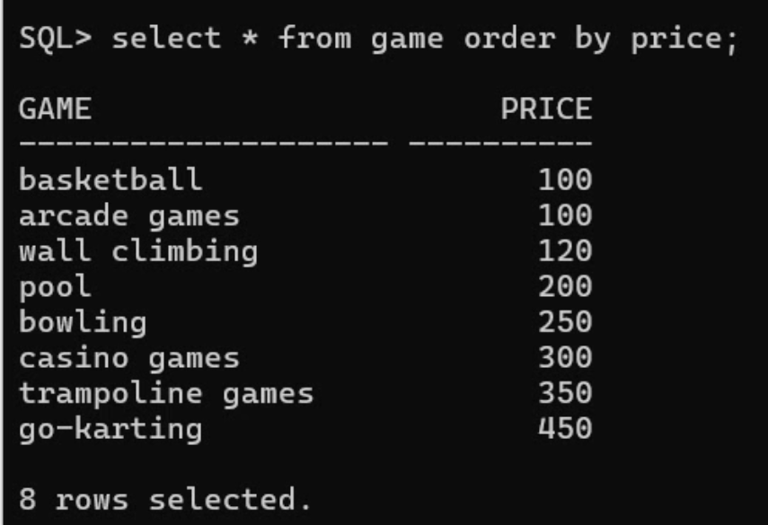
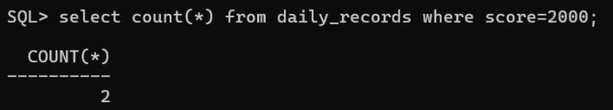
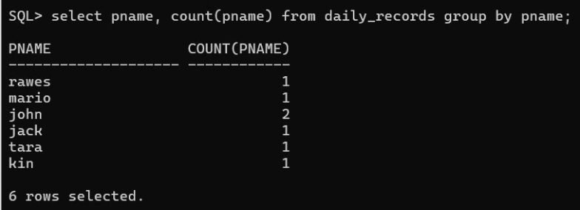
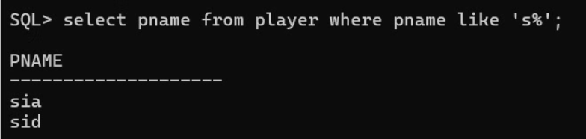
Running Queries

Slide 13
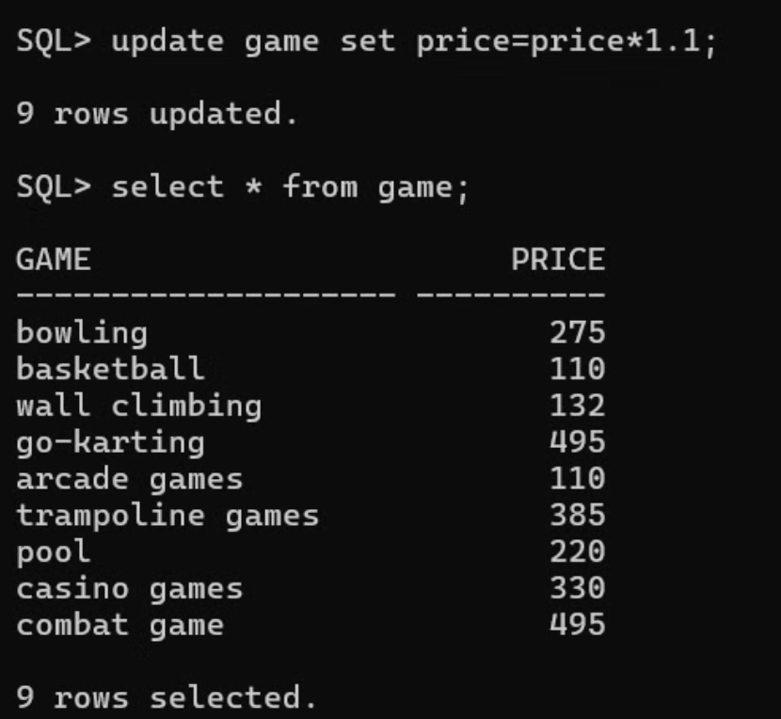
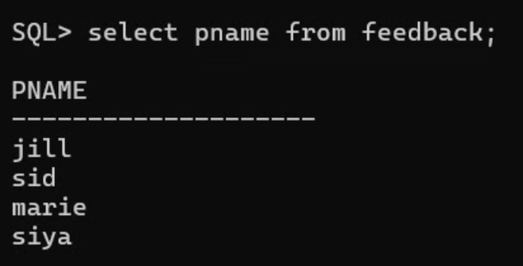
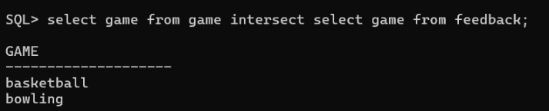
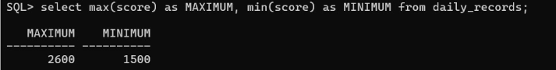
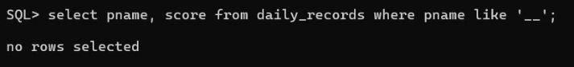
Running Queries

Slide 14
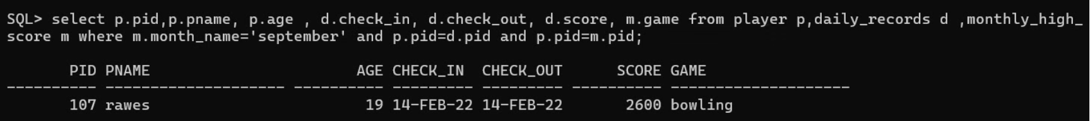
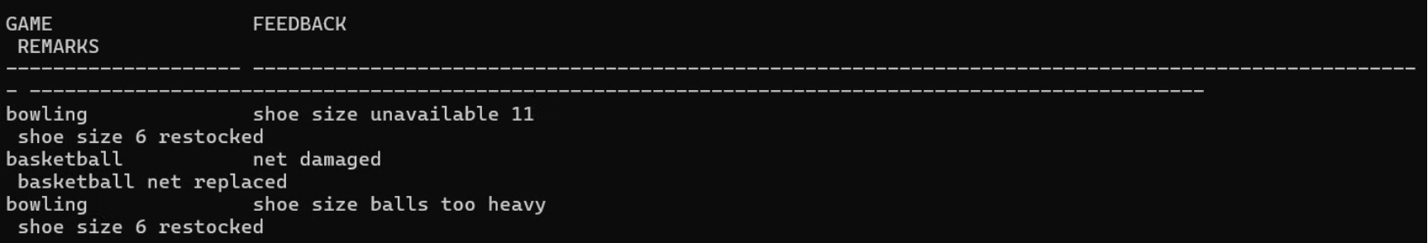
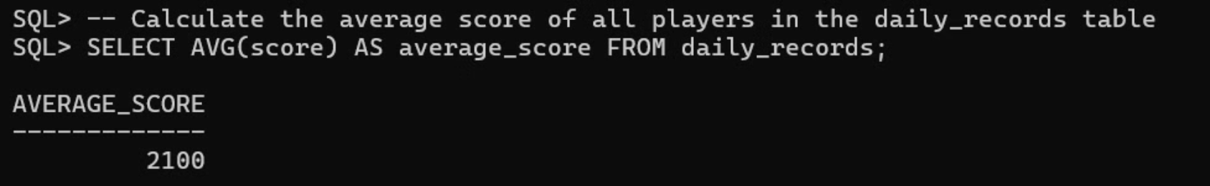
Running Queries

Slide 15
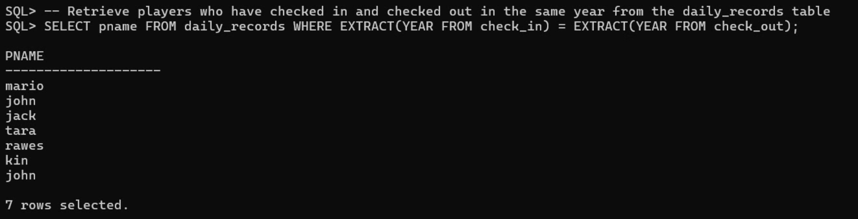
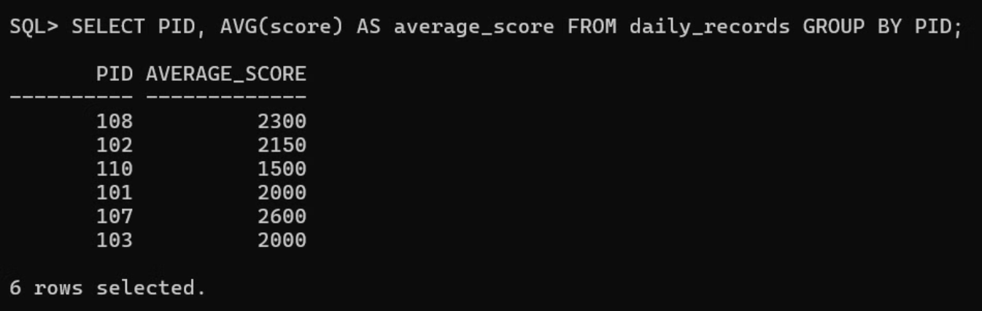
Running Queries

Slide 16




Technologies Utilized
Database
MySQL or PostgreSQL
Backend
Java or Python
Frontend
React or Angular
Leveraging technologies like MySQL/PostgreSQL for the database, Java/Python for the backend, and React/Angular for the frontend, the system is deployed on a secure cloud-based infrastructure.

Slide 17



Key Features
Automated Memberships
2
Easy management of customer memberships.
Real-Time Tracking
Up-to-the-minute inventory management.
1
Reporting Dashboard
3
Comprehensive overview of key metrics.
Key features include real-time inventory tracking, automated membership management, a comprehensive reporting dashboard, and customer loyalty program integration for seamless payment processing.

Slide 18
Implementation Challenges
1
Data Migration
2
Scalability
3
Security Measures
Challenges include migrating data from legacy systems, ensuring system scalability, implementing robust security measures, creating an intuitive user interface, and maintaining system performance.

Slide 19
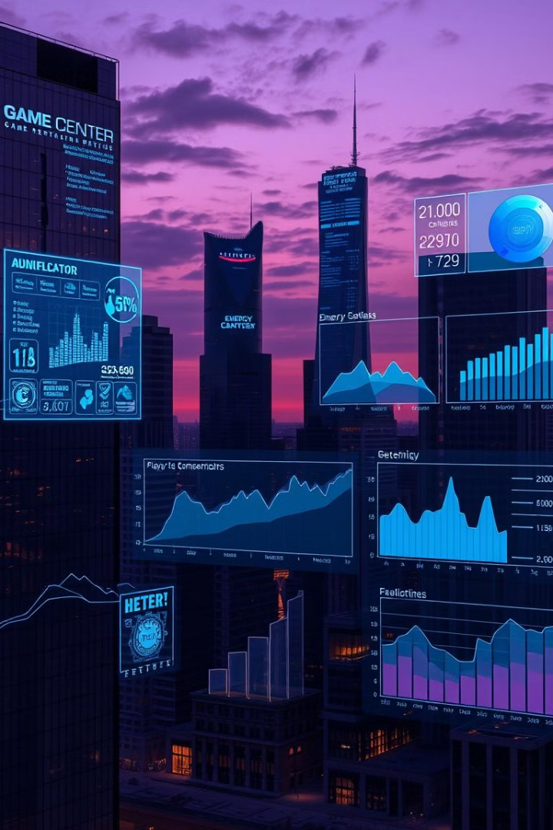
Project Impact and Future Vision
40%
Enhanced
Reduced Overhead
Customer Experience
Scalable
Business Solution
The project aims for a 40% reduction in administrative overhead, an improved customer experience, and enhanced business intelligence, with potential for future expansions and continuous improvement.

